Slide 1
ORTHOGRAPHIC PROJECTION
AN
INTRODUCTION

Slide 2
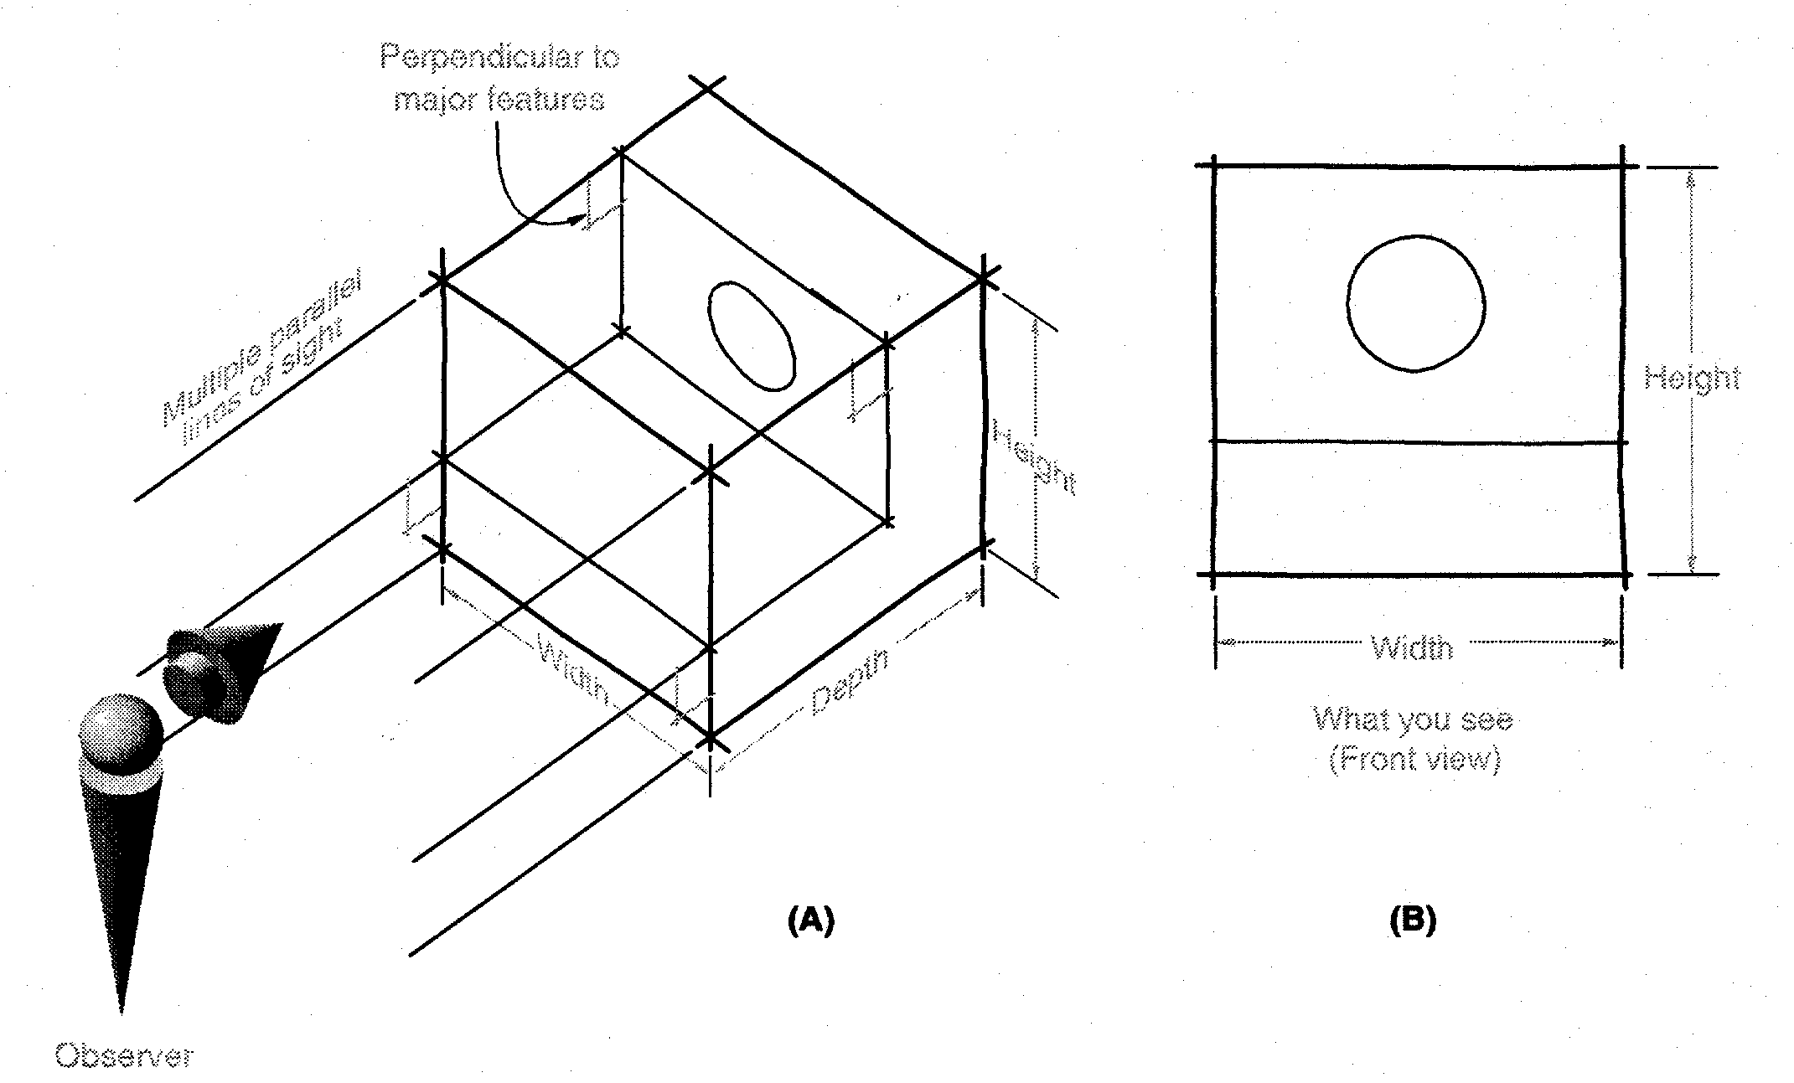
Orthographic Projections
Orthographic Projections are a collection of 2-D drawings that work together to give an accurate overall representation of an object.
Notes:
By definition for each element of a orthographic projection drawing you only present 2 of the three dimensions. Think of it as an observer look at one face, what do they see.
Any orthographic projection drawing normal has three views… Front view, Top view and side view (Right or left side view)

Slide 3
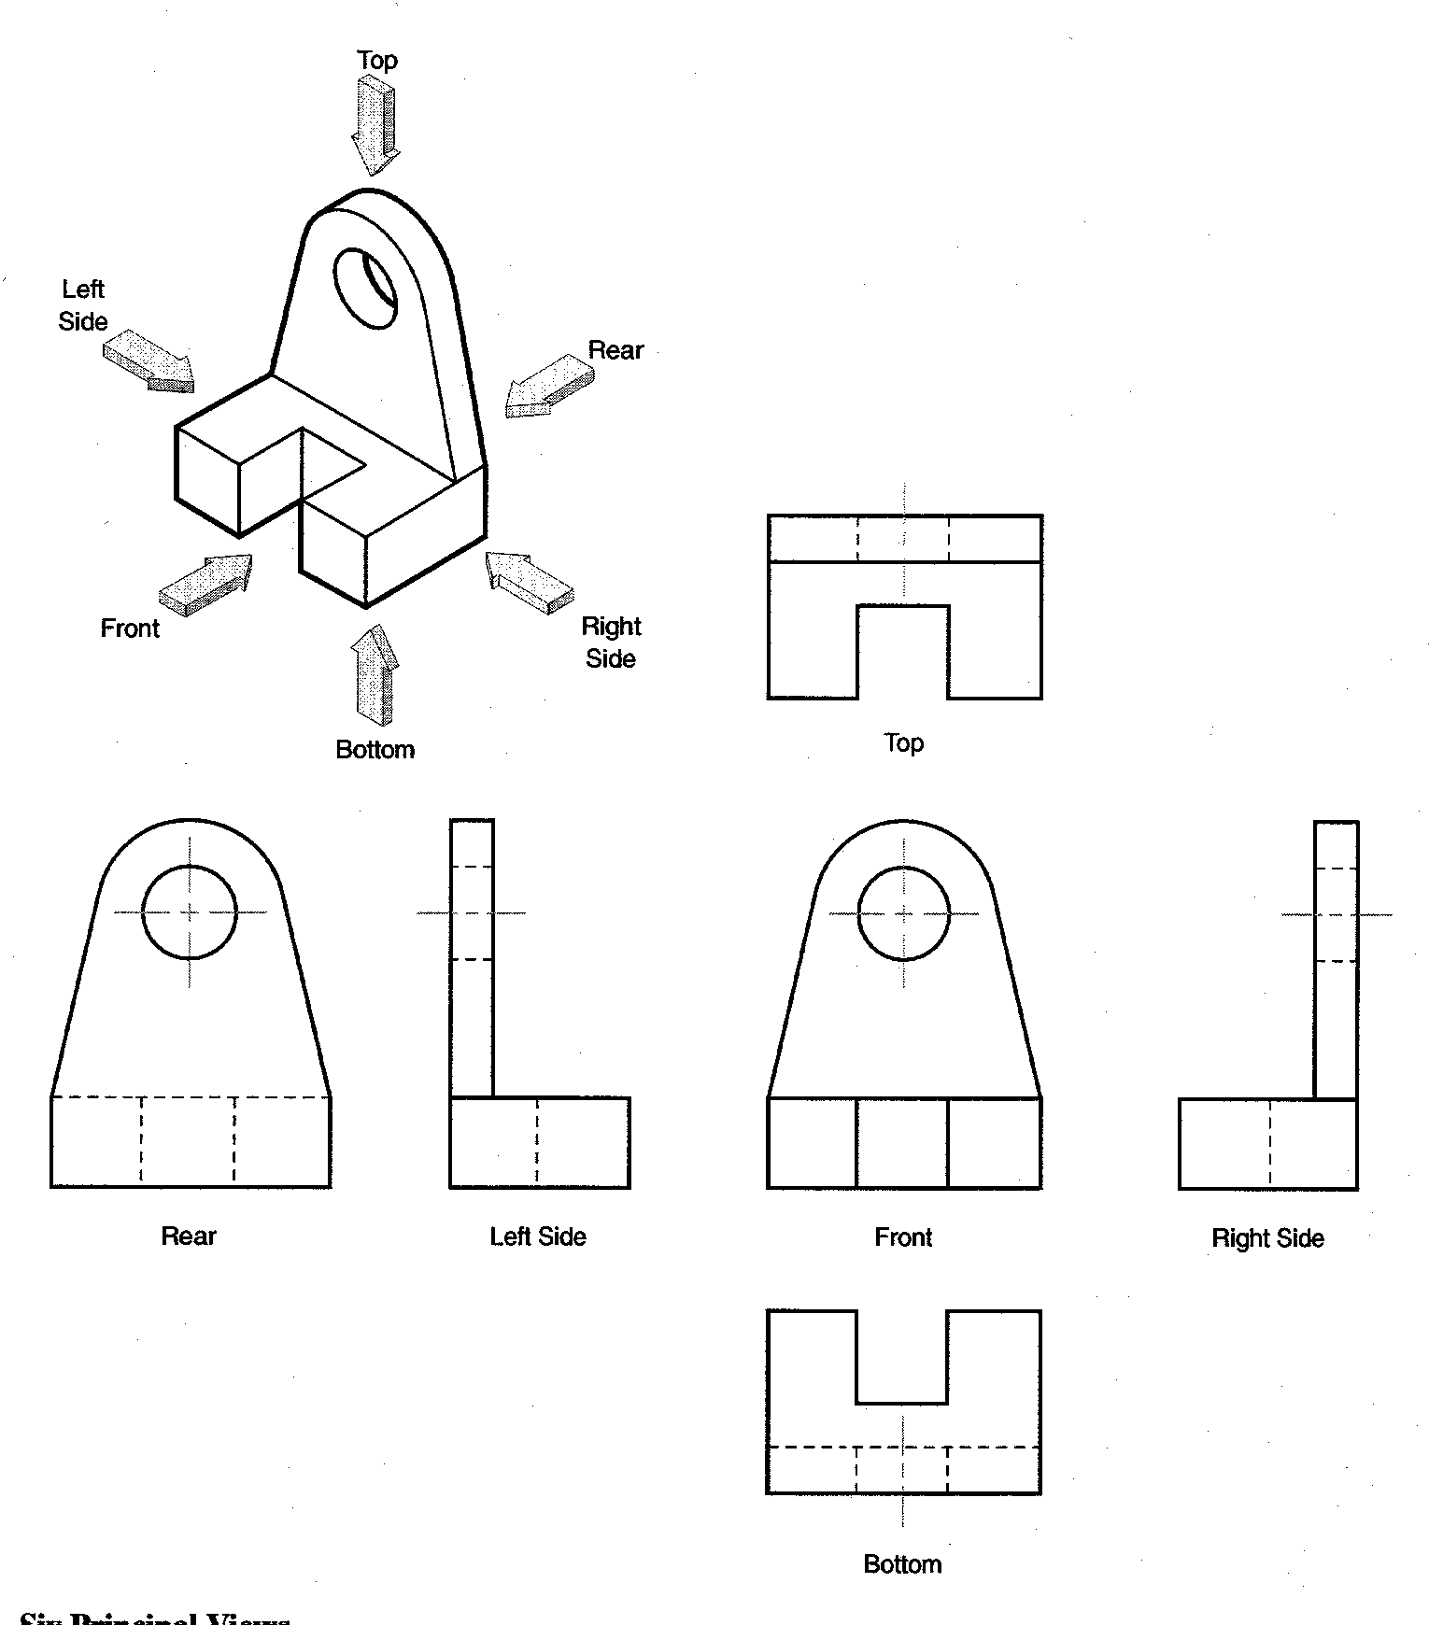
Defining the Six Principal Views or Orthographic Views
Notes:
Although any face could be chosen to be the front, once front and two other face are selected all are determined. There are really SIX PRINICPAL VIEWS as defined in the diagram.
Generally do not need all six to fully describe the object. A conventional Engineering Drawing will normally have 2 to 3 views unless it required more views to describe the geometry/ profile.
We know which ones they are on the drawing, because we always present them in the same relationship to each other. I.e. Top above front, right to right of front, etc. This convention is called as the Third angle method.. The other method in which the views can be placed is the First angle method in which the Top view is below front view, Right side view is on left side of front view. For this class we will be following the Third angle convention.
These are often called orthographic projections – because the line of sight is perpendicular to the principal view

Slide 4
Which Views to Present?
General Guidelines
Pick a Front View that is most descriptive of object
Normally the longest dimension is chosen as the width (or depth)
Most common combination of views is to use:
  Front, Top, and Side View
Notes:
Pick the views which will help in describing the object with highest clarity.
Explain what is an auxiliary view. Explain that they are drawn to show specific features that are not clear in the Principal views.

Slide 5
Glass Box Approach
Place the object in a glass box
Freeze the view from each direction (each of the six sides of the box) and unfold the box
Notes:
At this point, give an introduction to Glass-box approach for developing orthographic projection drawings.
Student slides contain snapshots of the animation

Slide 6
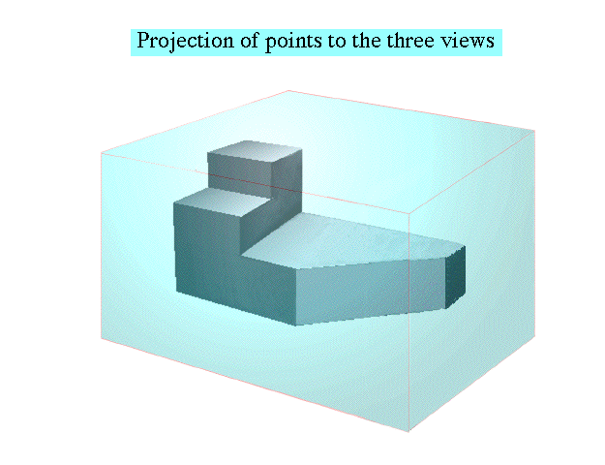
Glass Box Approach
Notes:
The object, whose orthographic projection needs to be drawn, is enclosed in a glass-box

Slide 7
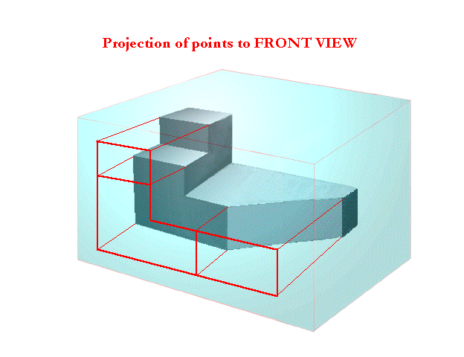
Glass Box Approach
Notes:
Project points on the front view of the glass-box

Slide 8
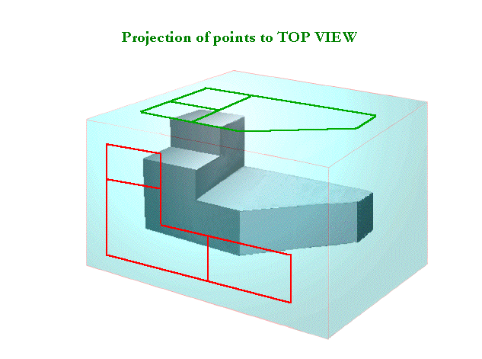
Glass Box Approach
Notes:
Project points on the the top view of the glass-box, just as done for front

Slide 9
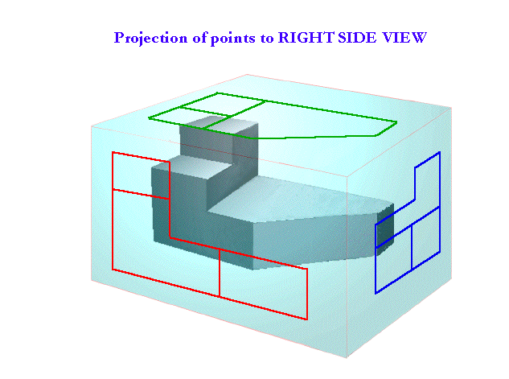
Glass Box Approach
Notes:
Project points on the right view of the glass-box, just as done for front and top

Slide 10
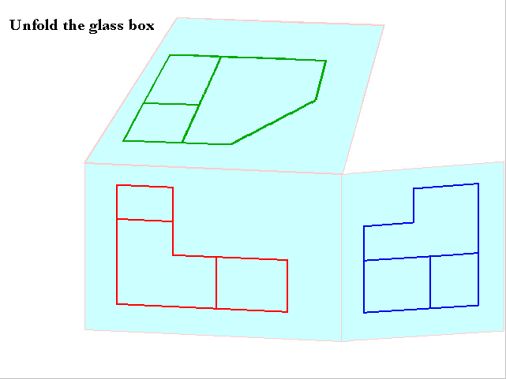
Glass Box Approach
Notes:
Unfold the glass box, see how the views align

Slide 11
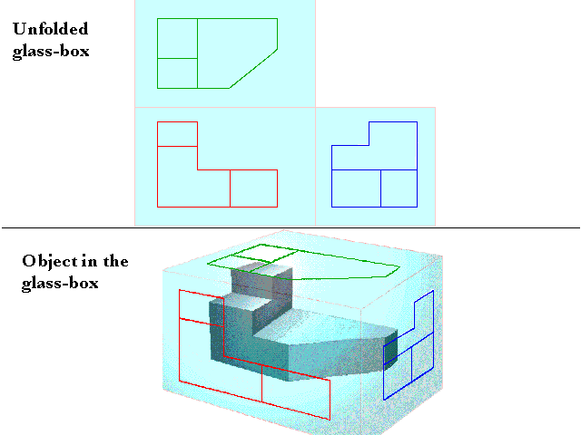
Glass Box Approach
Notes:
Unfold the glass box, see how the views align

Slide 12
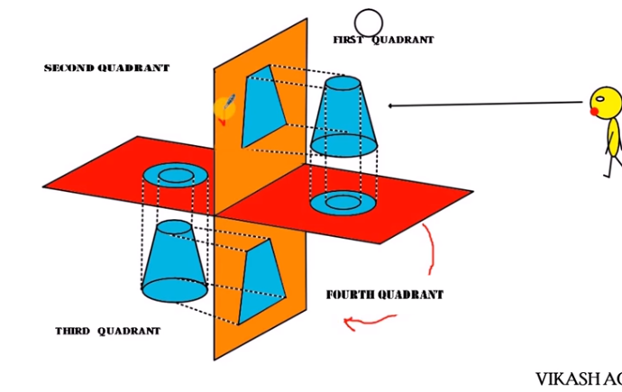


Slide 13
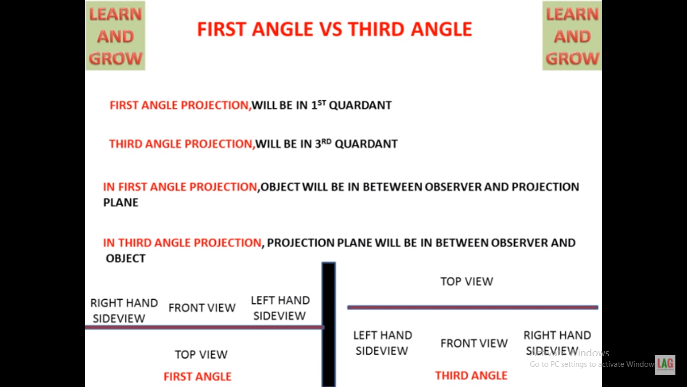

Slide 14
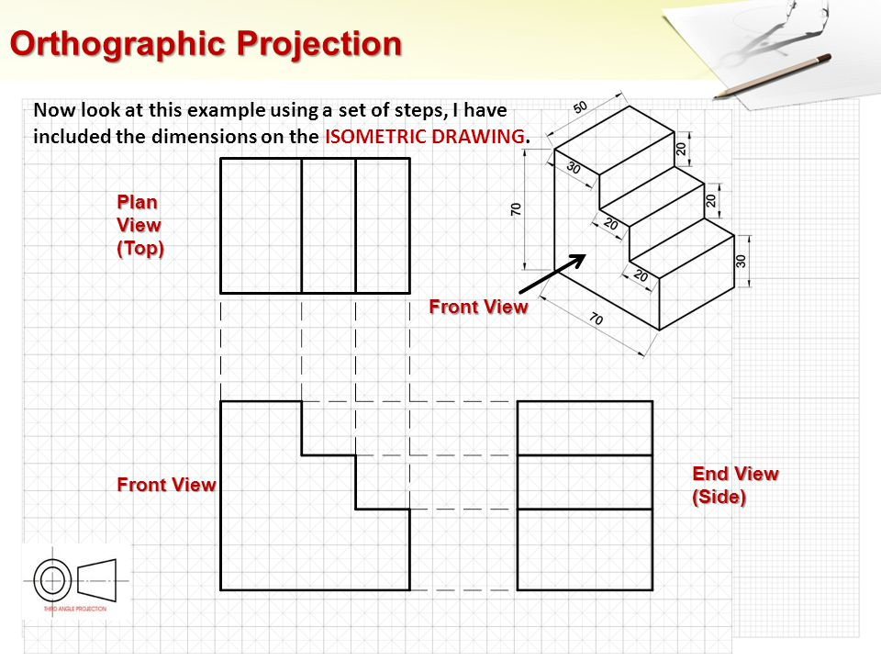
Draw orthographic view

Slide 16
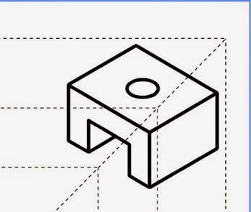

Slide 17
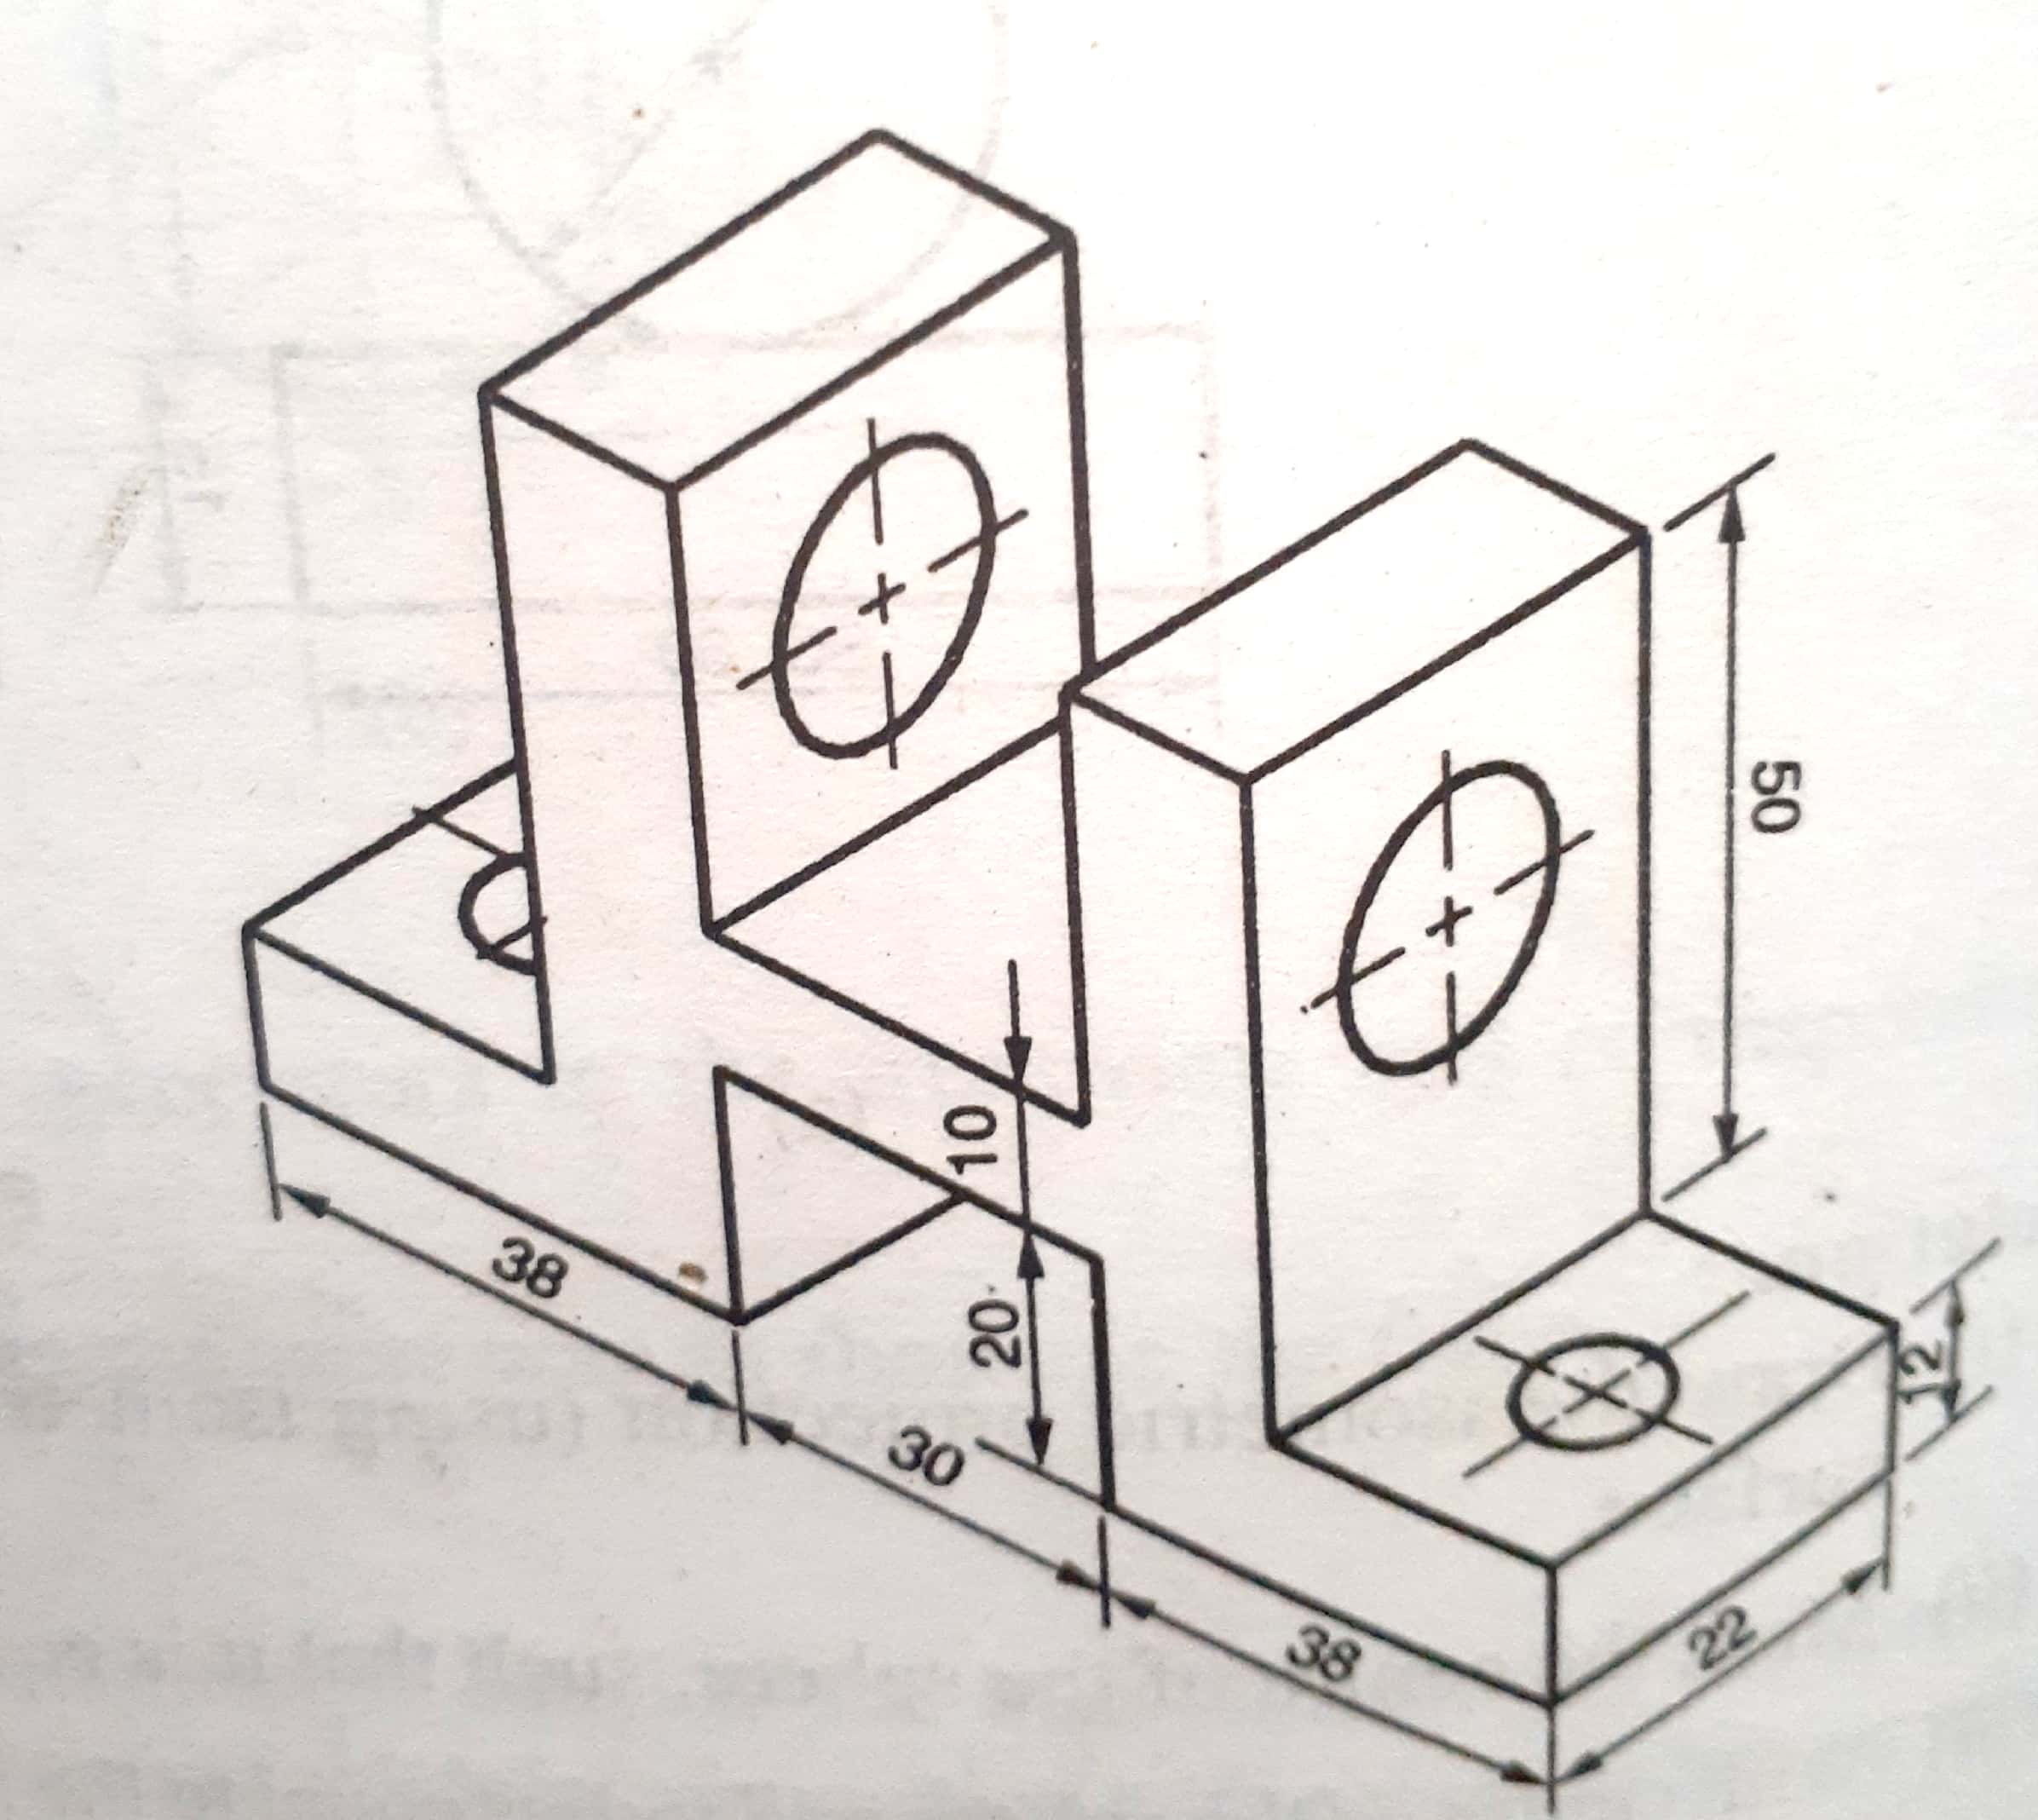

Slide 18
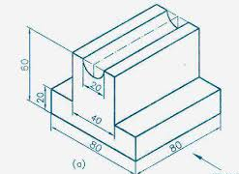
Draw orthographic view in First angle method of projection

Slide 19
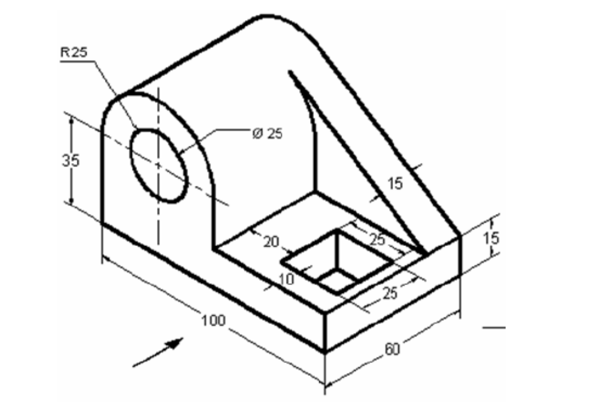
Draw orthographic view in First angle method of projection

Slide 20
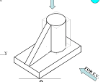
Draw orthographic view in Third angle method of projection

Slide 21
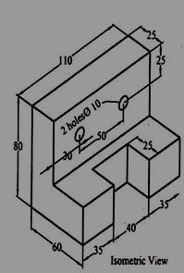
Draw orthographic view in Third angle method of projection

Slide 22
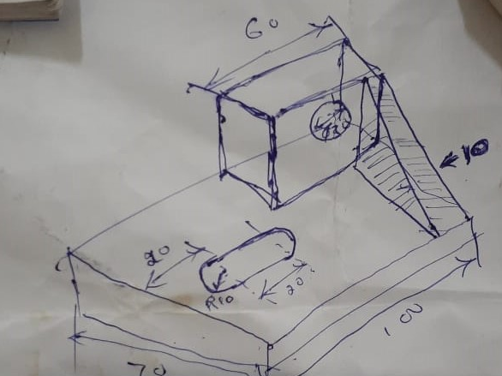
Draw orthographic view in Third angle method of projection

Slide 23
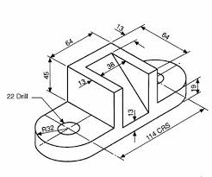
Draw orthographic view in Third angle method of projection

Slide 24
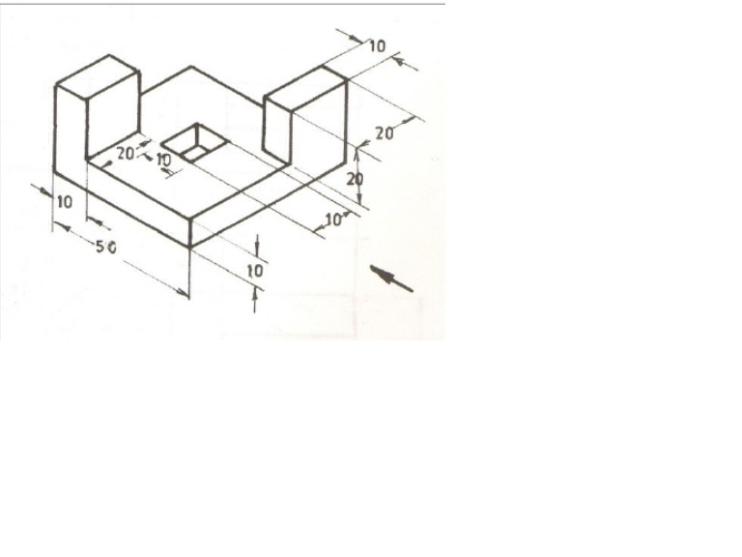
Draw orthographic view in Third angle method of projection

Slide 25
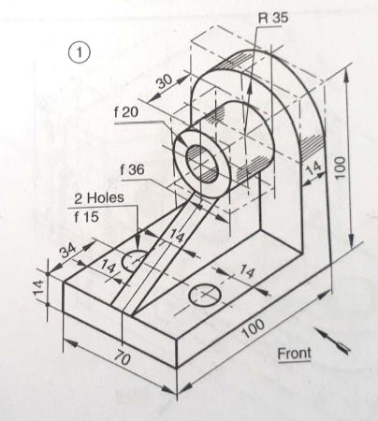

Slide 26
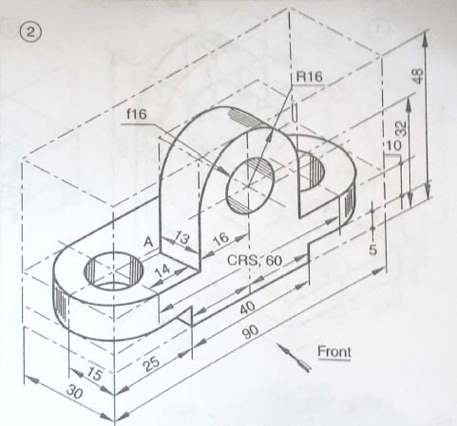

Slide 27
Lines on an engineering drawing signify more than just the geometry of the object and it is
important that the appropriate line type is used.
Line Thickness
For most engineering drawings you will require two thickness', a thick and thin line.
The general recommendation are that thick lines are twice as thick as thin lines.
 | A thick continuous line is used for visible edges and outlines.
 | A thin line is used for hatching, leader lines, short centre lines, dimensions and projections.
Line Styles
Other line styles used to clarify important features on drawings are:
 | Thin chain lines are a common feature on engineering drawings used to indicate centre lines. Centre lines are used to identify the centre of a circle, cylindrical features, or a line of symmetry.
 | Dashed lines are used to show important hidden detail for example wall thickness and holes..

Slide 28
Precedence of Lines
Visible lines takes precedence over all other lines
Hidden lines and cutting plane lines take precedence over center lines
Center lines have lowest precedence
0.6 mm
0.3 mm
0.6 mm
Notes:
From: Bertoline, Figure 2.40/ Pg 43
Note the thickness specified for given three types of lines
The precedence of lines governs which lines are drawn when more than one line occupies the same position on a drawing.
For example the figure above shows that while a visible line takes precedence over all other lines, hidden line and cutting plane line take precedence over center lines.
Standard engineering drawing practices requires the use of standard linetypes, which are called the alphabet of lines. The sizes show the recommended line thicknesses.

Slide 29
Dimensioning of circles
(a) shows two common methods of dimensioning a circle. One method dimensions the circle between two lines projected from two diametrically opposite points. The second method dimensions the circle internally.
(b) is used when the circle is too small for the dimension to be easily read if it was placed inside the circle.

Slide 30
In 3rd angle projection the _________ lies between ___________ and ____________
a) object, projection plane, observer
b) projection plane, object, observer
c) reference line, side view, front view
d) reference line, left side view, right side view

Slide 31
In the term ortho-graphic, ‘orthos’ means
a)Drawing
b)Straight
c)Projection
d)View

Slide 32
In 1st angle projection the positions of front and top views are __________
a) top view lies above the front view
b) front view lies above the top view
c) front view lie left side to top view
d) top view lie left side to front view

Slide 33
The orthographic projection, projection lines are ____ to each other.
a)Parallel
b)Perpendicular
c)Inclined
d)Any of the above

Slide 34
The following is not a principal view.
a)Bottom
b)Side
c)Top
d)Auxiliary

Slide 35
The line formed by intersection of principal planes is called _____________
a) projection line
b) origin line
c) line of intersection
d) reference line

Slide 36
The line formed by intersection of principal planes is called _____________
a) projection line
b) origin line
c) line of intersection
d) reference line

